Slide 1
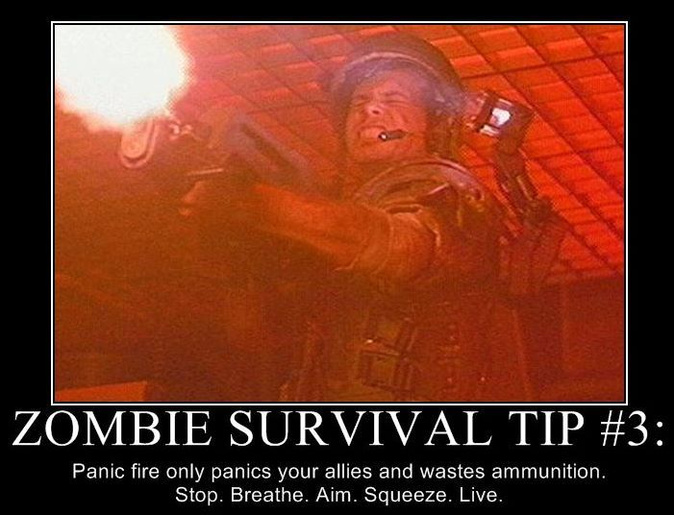
What to do in the event of a data deluge
Adina Howe
germslab.org (Genomics and Environmental Research in Microbial Systems)
Iowa State University, Ag & Biosystems Engr (January)
Slides available at www.slideshare.com/adinachuanghowe
NGS SEQUENCING
CIBNOR workshop, La Paz, 5/28/2015
Notes:
Thank organizers
Big data new, journey with big data
3 facts, 1” = 1000 yr, Major nutrient for crop growth, 50 yr recovery, Phosphorus, sustainable ag can mitiaget 0.3 – 1 ton of C/ha per year, 10% of all car carbon emissions

Slide 2
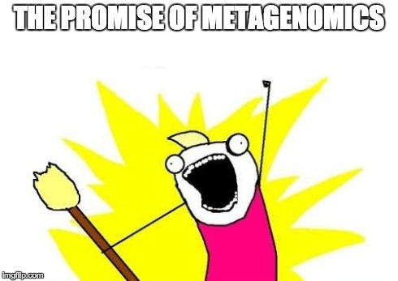
HOW DID WE GET HERE

Slide 3
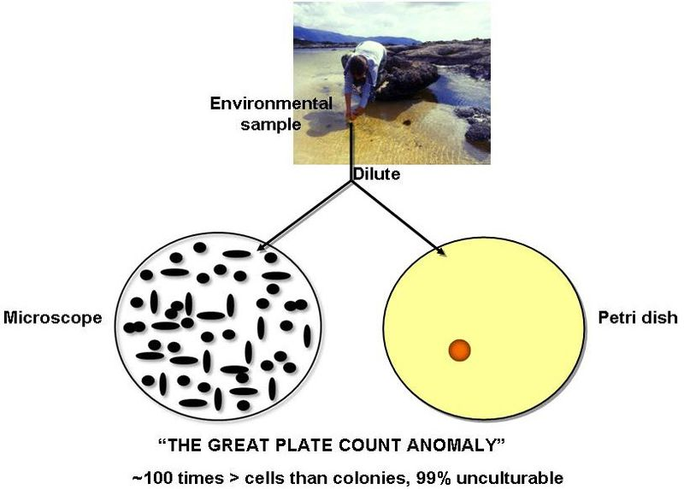
Understanding community dynamics
Who is there?
What are they doing?
How are they doing it?
Kim Lewis, 2010
Notes:
Historically, we have been asking these questions in model organisms.
The challenge of model organisms…comparing them to what we know is in the environment…

Slide 4
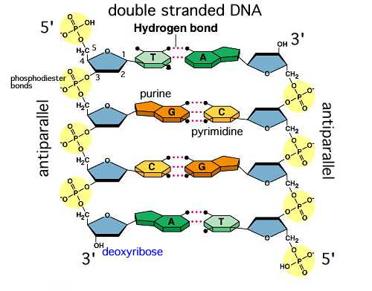
Gene / Genome Sequencing
Collect samples
Extract DNA
Sequence DNA
“Analyze” DNA to identify its content and origin
Taxonomy (e.g., pathogenic E. Coli)
Function (e.g., degrades cellulose)
Notes:
First automated DNA sequencing machines late 80s,
New ay of asking questions.

Slide 5
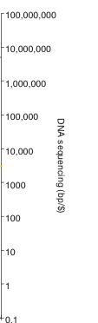
Cost of Sequencing
100,000,000
10,000,000
1,000,000
100,000
DNA Sequencing, Mbp per $
10,000
E. Coli genome 4,500,000 bp ($4.5M, 1992)
1,000
100
10
1
0.1
1990 1992 1994 1996 1998 2000 2003 2004 2006 2008 2010 2012 Year
Stein, Genome Biology, 2010
Notes:
Sequencing opened up the door to start building a catalog of some observed key microbial players. Driven by health and biotech interests.
This is the same set of reference genes that are still in use today.
Expensive.

Slide 6
Rapidly decreasing costs with NGS Sequencing
100,000,000
Next Generation Sequencing
4,500,000 bp (E. Coli, $200, presently)
10,000,000
1,000,000
100,000
10,000
1,000
DNA Sequencing, Mbp per $
100
10
1
0.1
1990 1992 1994 1996 1998 2000 2003 2004 2006 2008 2010 2012 Year
Stein, Genome Biology, 2010
Notes:
What changed the field was the invention of next generation technlogies, bascially allowing the throughput of these automated sequencers to be much higher and the cost of sequencing much cheaper.
So cheap in fact that instead of sequencing only one bacteria you could start sequencing multiple, even bacteria from complex environments.

Slide 7

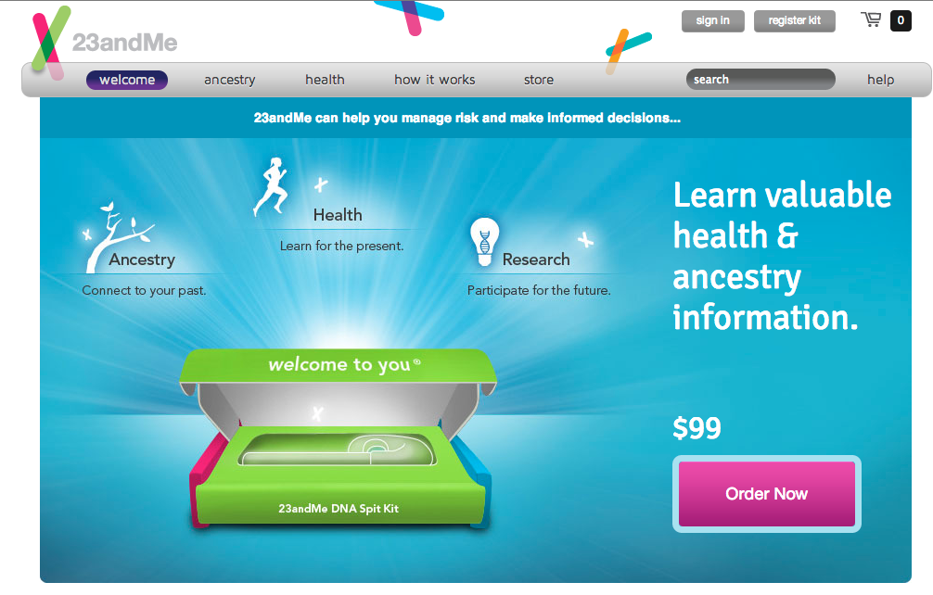
Effects of low cost sequencing…
1995
First free-living bacterium sequenced for billions of dollars and years of analysis
Personal genome can be mapped in a few days and hundreds to few thousand dollars
Notes:
Highlighted in recent news

Slide 8
The experimental continuum
Single Isolate Pure Culture
Enrichment
Mixed Cultures
Natural systems
Notes:
Opportunities and changes in the systems we study.
So then the question is not only who is there and what they are doing? But what are they doing together and how?

Slide 9
The era of big data in biology
1,000,000
NGS (Shotgun) Sequencing
(doubling time 5 months)
100,000,000
100,000,000
10,000,000
10,000,000
100,000
1,000,000
1,000,000
10,000
100,000
100,000
Computational Hardware
(doubling time 14 months)
DNA Sequencing, Mbp per $
1,000
10,000
10,000
Disk Storage, Mb/$
1,000
100
1,000
100
10
100
Sanger Sequencing
(doubling time 19 months)
10
10
1
1
1
0
0.1
0.1
1990 1992 1994 1996 1998 2000 2003 2004 2006 2008 2010 2012 Year
Stein, Genome Biology, 2010
Notes:
The growth – point out NGS imapct
Accompanied by challenges of computation…even to store data on.

Slide 10
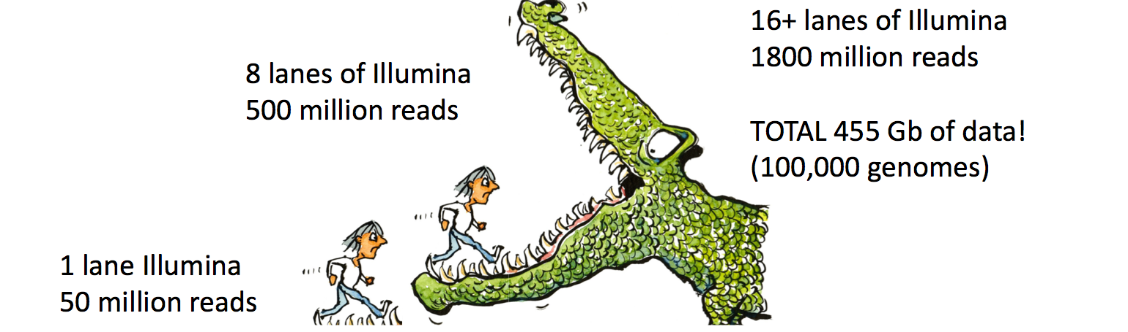
Postdoc experience with data
2003-2008 Cumulative sequencing in PhD = 2000 bp
2008-2009 Postdoc Year 1 = 50 Gbp
2009-2010 Postdoc Year 2 = 450 Gbp
= 50 Tbp
= 500 Tbp budgeted
Notes:
Data during my career really reflects this groth.
During postdoc, first year, 50 million reads to about 40x that within literally 9 months. data increased 25x million times….
Notice the gap from 2010 – 2014, figuring stuff out.

Slide 11
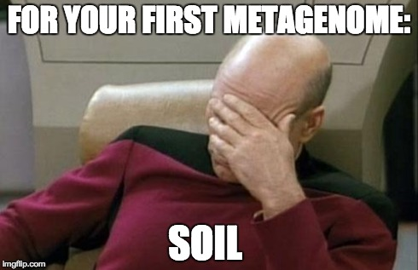

Slide 12
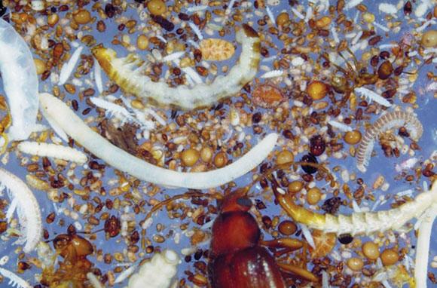
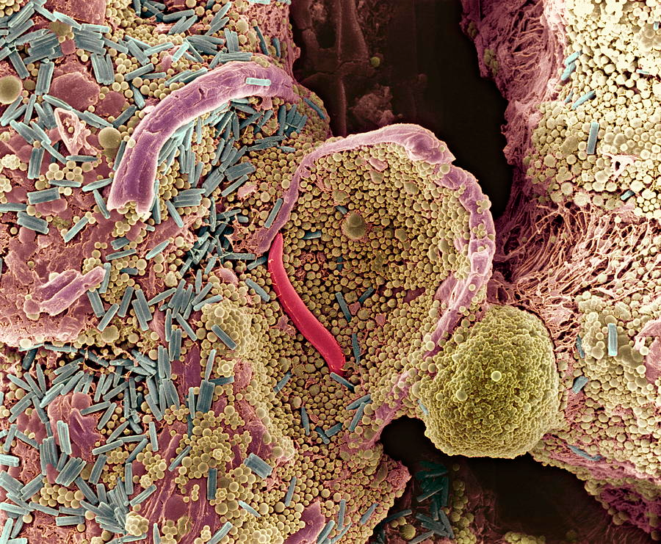
THE DIRT ON SOIL
MAGNIFICENT BIODIVERSITY
Biodiversity in the dark, Wall et al., Nature Geoscience, 2010
Jeremy Burgress
Notes:
Why do we need such vol. of data?
Most of us now recognize that microbial communities generally exhibit a high level of diversity, much highter than previously assume by what was revealed by classical microscopy and basic culturing techniques.
In soil, even in one gram of soil, there is estimated to be more microbial species than there are stars in the galaxy. We have far to go for any comprehensive characterization of any single soil community. A key question then Is why is soil diversity so high?

Slide 13
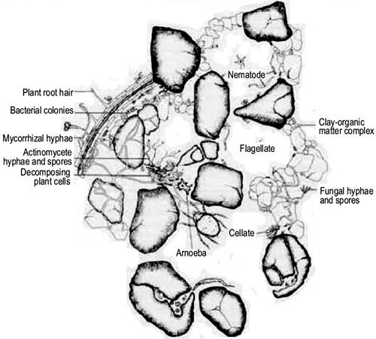
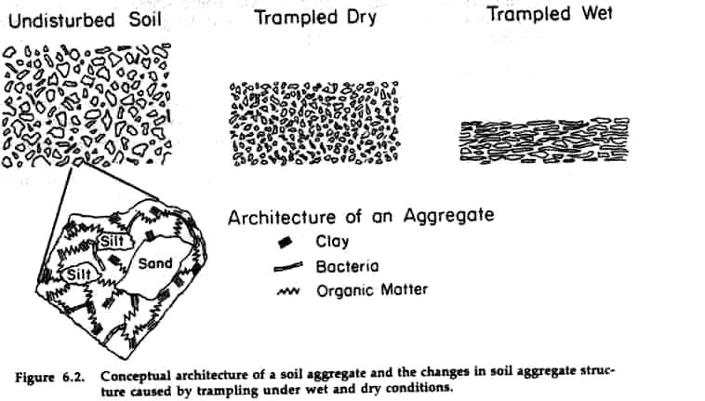
THE DIRT ON SOIL
SPATIAL HETEROGENEITY
http://www.fao.org/
www.cnr.uidaho.edu
Notes:
One reason may be that the soil structure provides unique niche that provide a high diversity of food resources.
Its varied structure provides stable, protective, and even ancient environments for microorganims.

Slide 14
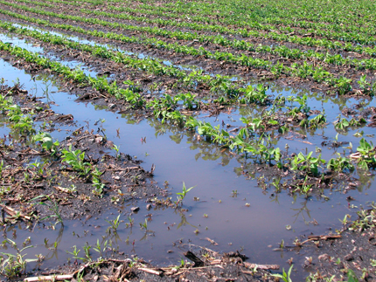
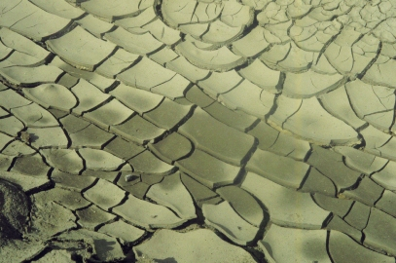
THE DIRT ON SOIL
DYNAMIC
Notes:
Soil investigations are further complicated by the primarily dormant state of the large majority of the soil microbial population. The turnover rate of soil microbes is predicted to be over 30 fold and even up to 300 fold slower than that of microbes in the oceans.
And these microbes live in relatively unpredicatlbe patterns of pertubations – for example rainfall or leaf litter introduction. They also undergo defined temporal perturbations – diurnal energy input.

Slide 15
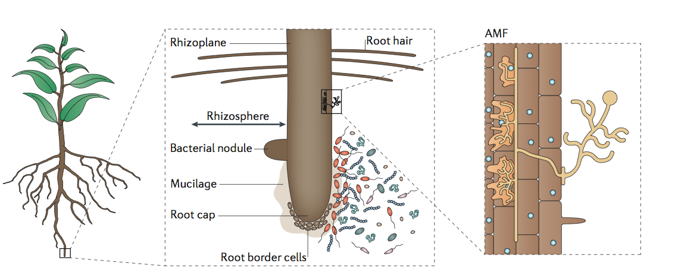
THE DIRT ON SOIL
INTERACTIONS: BIOTIC, ABIOTIC, ABOVE, BELOW, SCALES
Philippot, 2013, Nature Reviews Microbiology
Notes:
This complexity in the soil has formed a dynamic microbial ecosystem which interacts with nutrients, plants, and the soil structure itself at multiple scales.
I would argue that we as a field are still trying to find tractable methods of accessing these interactions and understanding the drivers of “healthy” or “productive” soils.

Slide 16
Methods to tackle metagenomic datasets
Computational
Experimental
Bottlenecks for microbiologists
Notes:
Given soils complexity

Slide 17
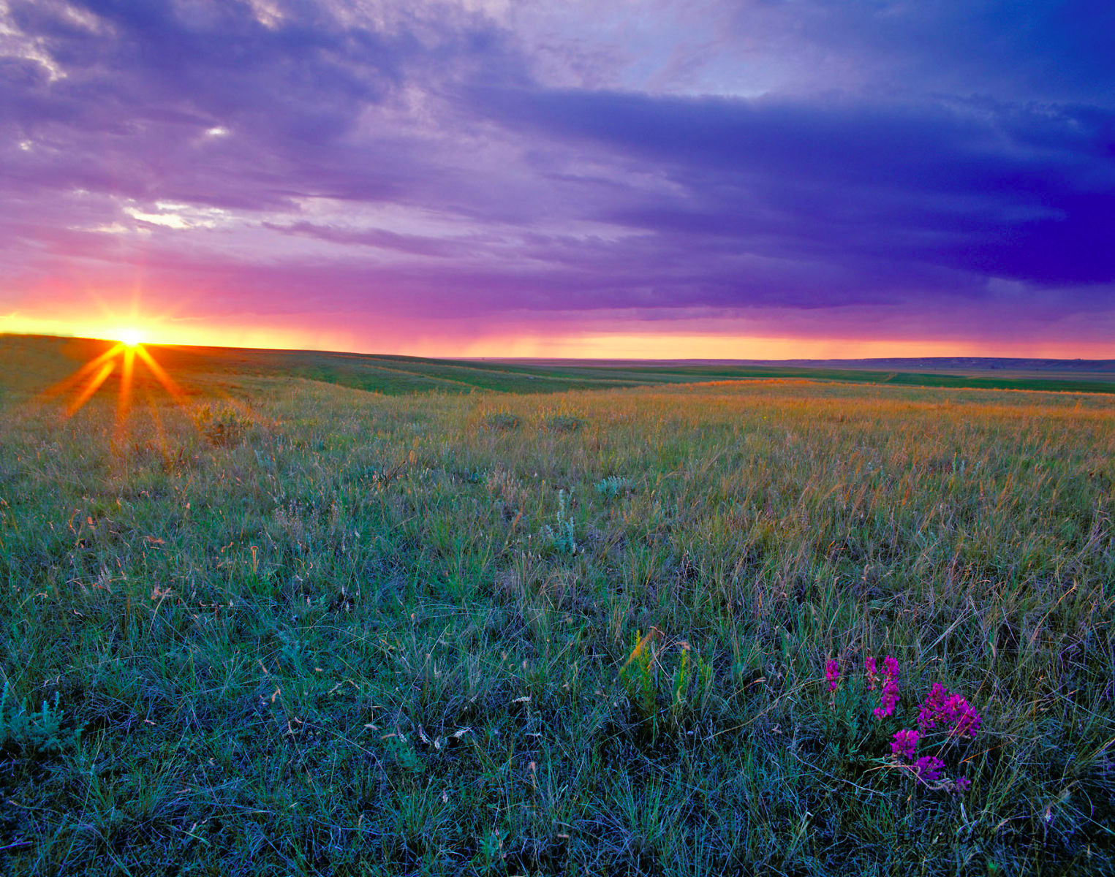
Tackling Soil Biodiversity
C. Titus Brown, James Tiedje, Qingpeng Zhang, Jason Pell (MSU)
Janet Jansson, Susannah Tringe (JGI)
Source: Chuck Haney
Notes:
Soil biodiversity is amazing.
Great Prairie – world’s most fertile. Important reference site for the biological baseis and ecosystems of soil microbial communities. It sequesters most carbon, produces large amount of biomass anually, key for biofuels and security.
Know little about the who / what in these soils.
Excitement about what we could clean now with the technologies.

Slide 18
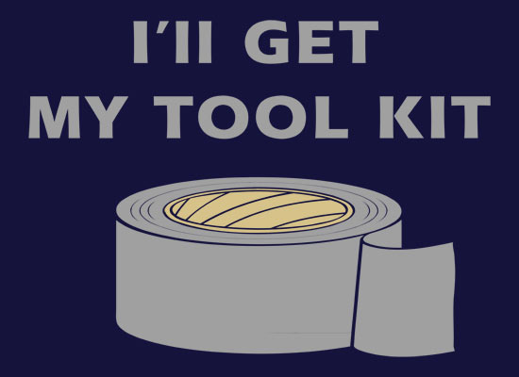
A Slight Digression: Decisions for the new microbial ecologist

Slide 19
Getting the most out of your data
Complex Samples
ID, Abundance, Function
Pros:
Commonly used approach
Deep characterization
Cons:
Limited knowledge
Resolution remains low
16S rRNA amplicon sequencing
Patrick Chain
Notes:
Another tool???
There are two additional points:
1) You are at the mercy of your current state of knowledge (database!) –Applaud Adina – resources for soil
2) Repetitive elements (within database or genome or among genomes), they are the bane of genomics…

Slide 20
Getting the most out of your data
Complex Samples
ID, Abundance, Function
Pros:
Commonly used approach
Deep characterization
Cons:
Limited knowledge
Resolution remains low
16S rRNA amplicon sequencing
Shotgun sequencing
Pros:
Massive data
Identity and abundance answered simultaneously
Look at all data**
Cons:
Massive data (short + with errors)
Lack of specificity due to FPs from genomic redundancy
Difficult to detect novel genomes – must infer
Pros:
Large contigs
Positional Information
Most direct method to identify novel orgs/genes
Cons:
Computational resource intensive
Assembling difficulties
Sequencing error
genomic redundancy - chimeras
Assembly based
Read-based / Mapping Methods
Cons:
Massive data (short + with errors)
Lack of specificity due to FPs from genomic redundancy
Difficult to detect novel genomes – must infer
Patrick Chain
Notes:
Another tool???
There are two additional points:
1) You are at the mercy of your current state of knowledge (database!) –Applaud Adina – resources for soil
2) Repetitive elements (within database or genome or among genomes), they are the bane of genomics…

Slide 21
Getting the most out of your data
Complex Samples
ID, Abundance, Function
Pros:
Commonly used approach
Deep characterization
Cons:
Limited knowledge
Resolution remains low
16S rRNA amplicon sequencing
Shotgun sequencing
Pros:
Massive data
Identity and abundance answered simultaneously
Look at all data**
Cons:
Massive data (short + with errors)
Lack of specificity due to FPs from genomic redundancy
Difficult to detect novel genomes – must infer
Pros:
Large contigs
Positional Information
Most direct method to identify novel orgs/genes
Cons:
Computational resource intensive
Assembling difficulties
Sequencing error
genomic redundancy - chimeras
Assembly based
Read-based / Mapping Methods
Cons:
Massive data (short + with errors)
Lack of specificity due to FPs from genomic redundancy
Difficult to detect novel genomes – must infer
The answer is always “it depends”.
Patrick Chain
Notes:
Another tool???
There are two additional points:
1) You are at the mercy of your current state of knowledge (database!) –Applaud Adina – resources for soil
2) Repetitive elements (within database or genome or among genomes), they are the bane of genomics…

Slide 22
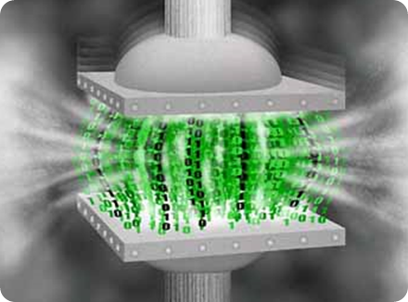
Example #1: Data compression
http://siliconangle.com/files/2010/09/image_thumb69.png
Notes:
With growing volumes of data, the most obvious way to tractably access this data is to “smartly” reduce this data.

Slide 23
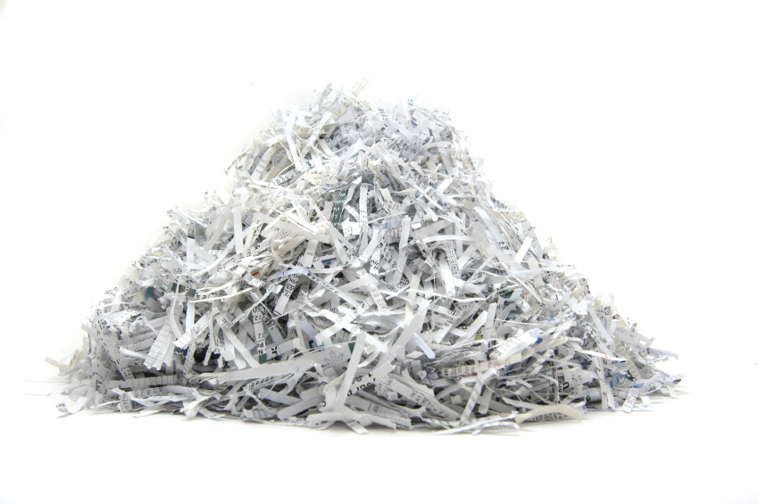
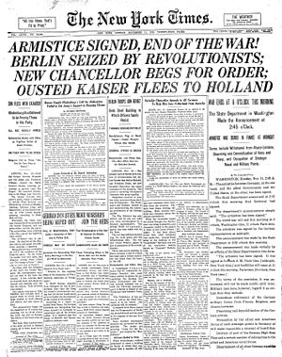
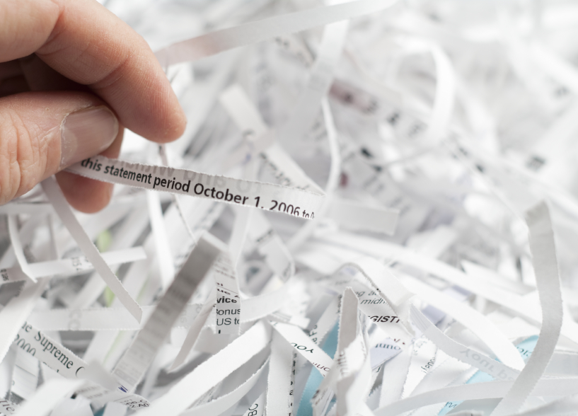
de novo assembly
Raw sequencing data (“reads”)
Computational algorithms
Informative genes / genomes
Compresses dataset size significantly
Improved data quality (longer sequences, gene order)
Reference not necessary (novelty)
Notes:
One genomic way to reduce data is a process known as assembly.
Assembly has been around since the sequencing of single organisms.

Slide 24
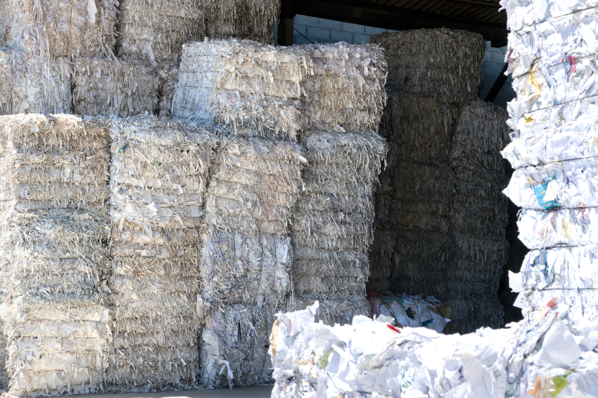
Metagenome assembly…a scaling problem.
Notes:
Metagenomics…a problem of scale

Slide 25
Shotgun sequencing and de novo assembly
It was the Gest of times, it was the wor
, it was the worst of timZs, it was the
isdom, it was the age of foolisXness
, it was the worVt of times, it was the
mes, it was Ahe age of wisdom, it was th
It was the best of times, it Gas the wor
mes, it was the age of witdom, it was th
isdom, it was tIe age of foolishness
It was the best of times, it was the worst of times, it was the age of wisdom, it was the age of foolishness
Notes:
Assembly is the process of trying to come up with a consensus sequence based on finding overlaps in small fragments.
In this example, we are coming up with a solution of one sentence using 8 fragments.
In metagenomic assembly, you are trying to come up with hundreds to thousands to even millions of genomes using billions of fragments.
And to do this, you have to compare each fragment to every other one in the dataset, making it very computationally intensive.

Slide 26
Practical Challenges – Intensive computing
Months of “computer crunching” on a super computer
Howe et al, 2014, PNAS
Notes:
Even the smallest dataset that I had at the beginning of my postdoc required several months on a supercomputer, something having over 100 GB of RAM. These were resources I simply didn’t have at this time. And for my larger datasets, there was simply nothing I could do with them, they would essentially crash any available assembly program that existed.
So I had to come up with a way to deal with all of this data or essentially, there were a handful of Pis that had just invested tens of thousands of dollars in a project where we couldn’t tractably handle the datasets.

Slide 27
Practical Challenges – Intensive computing
Months of “computer crunching” on a super computer
Assembly of 300 Gbp (70,000 genomes worth) can be done with any assembly program in less than 14 GB RAM and less than 24 hours.
50 Gbp = 10,000 genomes
Howe et al, 2014, PNAS
Notes:
I’m going to tell you now a little bit about how we were able to do this and there actually two different strategies we had to combine. Point out how many genomes this is. 70000

Slide 28
Natural community characteristics
Diverse
Many organisms (genomes)
Notes:
First start thinking about what tare the natural chracteristics of environemntal communities.
Diverse.: There are multiple genomes, and even potentially millions of species, in a sample.

Slide 29
Natural community characteristics
Diverse
Many organisms (genomes)
Variable abundance
Most abundant organisms, sampled more often
Assembly requires a minimum amount of sampling
More sequencing, more errors
Sample 1x
Notes:
Variable abundance in nature, some are highly abundant some are not.

Slide 30
Natural community characteristics
Diverse
Many organisms (genomes)
Variable abundance
Most abundant organisms, sampled more often
Assembly requires a minimum amount of sampling
More sequencing, more errors
Sample 1x
Sample 10x
Notes:
This diversity and distribution of abundances means that we are unevenly sampling strains in the environment.
If we want to sample the rarerest species….we need

Slide 31
Natural community characteristics
Diverse
Many organisms (genomes)
Variable abundance
Overkill
Most abundant organisms, sampled more often
Assembly requires a minimum amount of sampling
More sequencing, more errors
Sample 1x
Sample 10x
Notes:
A strategy we came up with was can we come up with a way to come up with the minimal dataset that you need for assembly, discarding these reads from this overkill section?

Slide 32
Digital normalization
Brown et al., 2012, arXiv Howe et al., 2014, PNAS
Zhang et al., 2014, PLOS One
Notes:
Lossy compression
From a sequencing standpoint then, what we see is that for a given genome (represented here as a dotted line), we start sampling fragments from it.

Slide 33
Digital normalization
Brown et al., 2012, arXiv Howe et al., 2014, PNAS
Zhang et al., 2014, PLOS One
Notes:
As we sample more, we will have some sequences which will have errors in it.

Slide 34
Digital normalization
Brown et al., 2012, arXiv Howe et al., 2014, PNAS
Zhang et al., 2014, PLOS One
Notes:
And we’ll keep sequencing this genome, randomly sampling different parts of it. We’ll get to a point, where we’ll have enough sequences where we can make a good guess at what the original sequence may have looked like.

Slide 35
Digital normalization
Brown et al., 2012, arXiv Howe et al., 2014, PNAS
Zhang et al., 2014, PLOS One
Notes:
For assembly, you need a minimum amount of information. So anything beyond this 6 is excessive or redundant information.

Slide 36
Digital normalization
Brown et al., 2012, arXiv Howe et al., 2014, PNAS
Zhang et al., 2014, PLOS One
Notes:
So we can discard or set aside this read and not use it for our assembly. And that actually turns out to be a good thing because in discarding this information, we’re actually removing data with errors in it.

Slide 37
Digital normalization
Scales datasets for assembly up to 95% - same assembly outputs.
Genomes, mRNA-seq, metagenomes (soils, gut, water)
Brown et al., 2012, arXiv Howe et al., 2014, PNAS
Zhang et al., 2014, PLOS One
Notes:
minimal dataset needed for an assembly of the dataset here in pink and a redundant set of information which we have set aside.
In setting aside these reads here in the red, discard errors
Improve assembly

Slide 38
Tackling Soil Biodiversity
C. Titus Brown, James Tiedje, Qingpeng Zhang, Jason Pell (MSU)
Janet Jansson, Susannah Tringe (JGI)
Source: Chuck Haney
Notes:
Soil biodiversity is amazing.
Great Prairie – world’s most fertile. Important reference site for the biological baseis and ecosystems of soil microbial communities. It sequesters most carbon, produces large amount of biomass anually, key for biofuels and security.
Know little about the who / what in these soils.
Excitement about what we could clean now with the technologies.

Slide 39
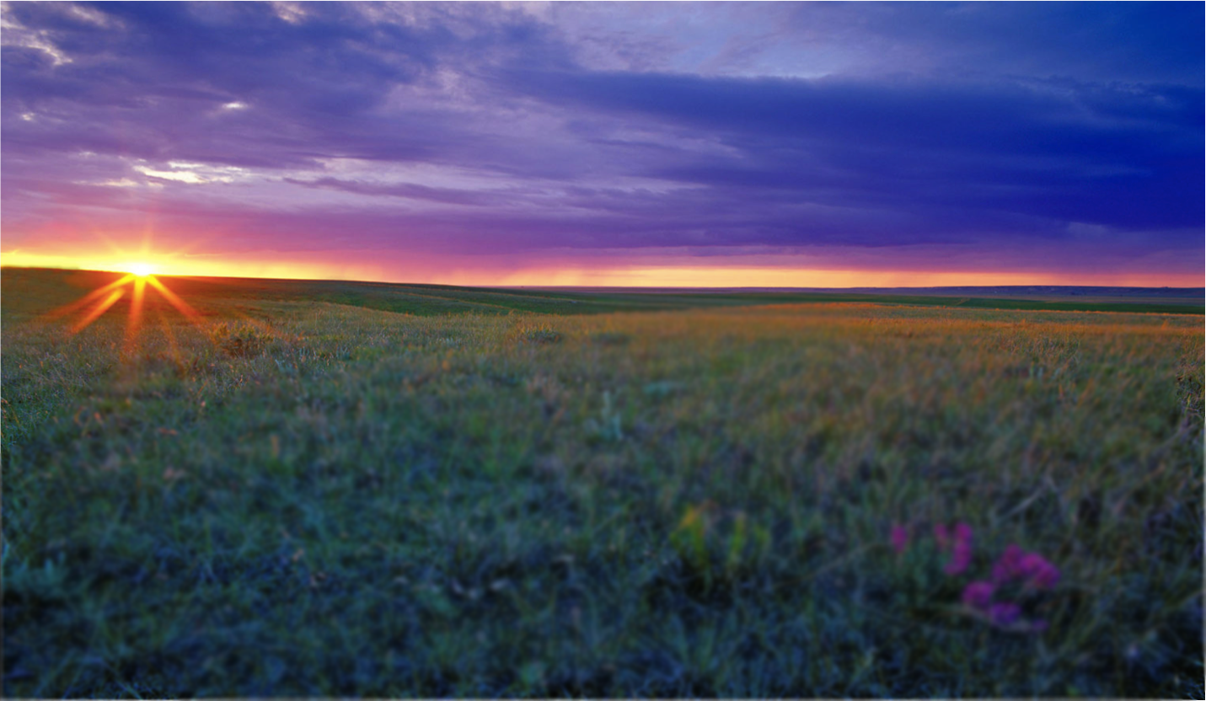
The reality?

Slide 40
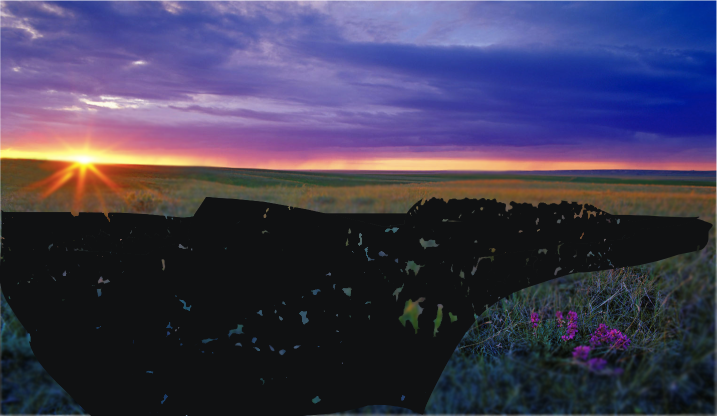
More like…
Howe et. al, 2014, PNAS
Source: Chuck Haney
Notes:
More than half, 50-80% sequences unknown in soil, gut microbiome

Slide 41
The Future
More data, more samples, better references
Expense will be in sampling – not sequencing or even data analysis
All biologists will need to know how to use a pipette and write computer programs
Large-scale, collaborative projects rather than single PI efforts

